Slide 1
Toxic Comment Classification
Krishna Priya Gajula
Brian Hoang
Anjani Mallampati
Archana Yadawa
Instructor: Professor Sithu Aung

Slide 2
Introduction
Purpose: It is a common struggle and necessity for many social media platforms to be able to identify toxic comments
Kaggle Competition: Toxic Comment Classification Challenge
Dataset: comments from Wikipedia
Notes:
dataset of comments from Wikipedia’s talk page edits

Slide 3
Overview
Part 1: Kaggle Competition
Part 2: Chrome Extension

Slide 4
Part 1:
Kaggle Competition

Slide 5
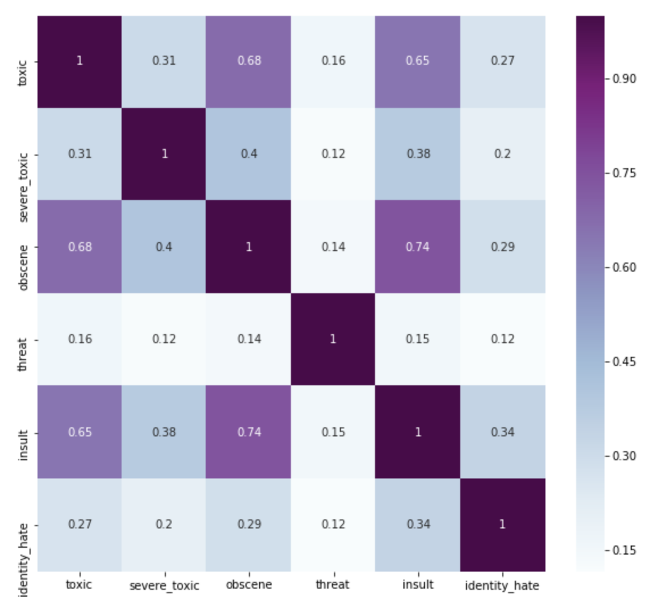
Correlation Matrix

Slide 6
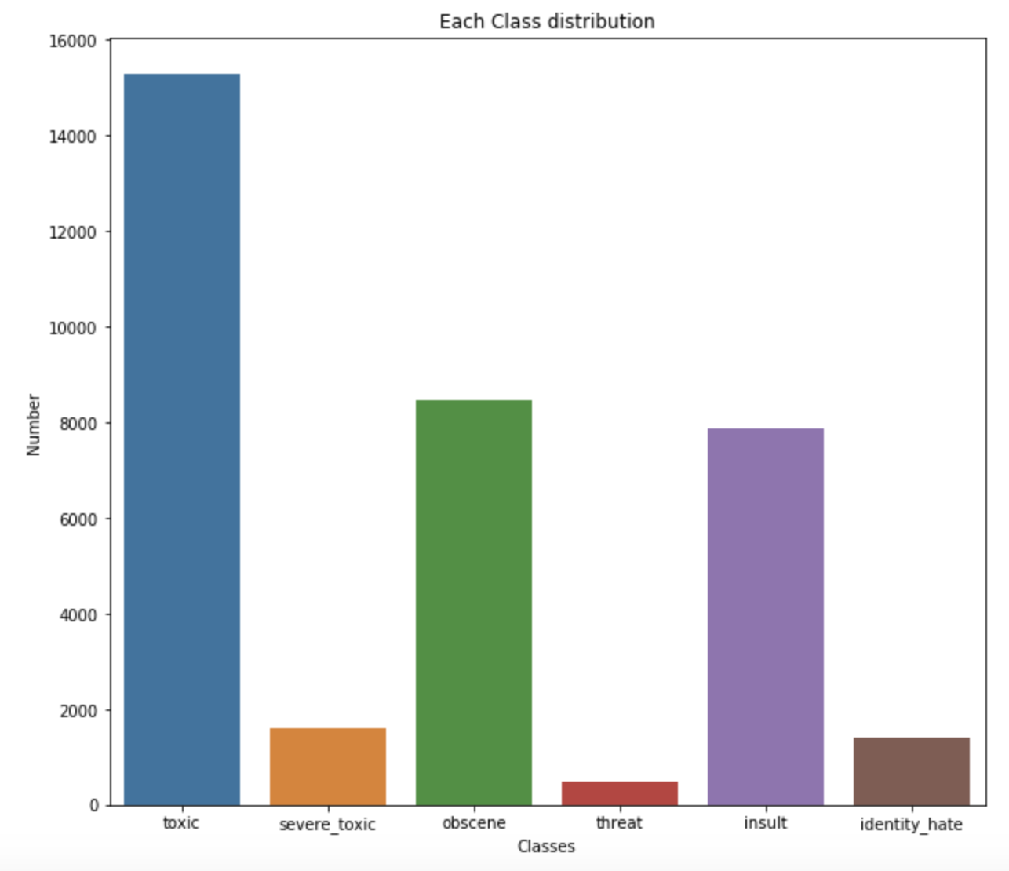
Class Distribution

Slide 7
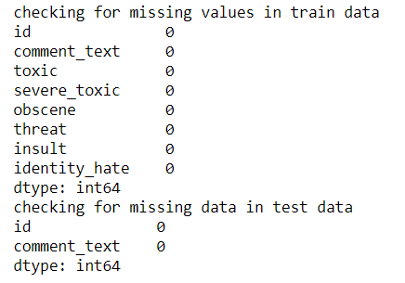

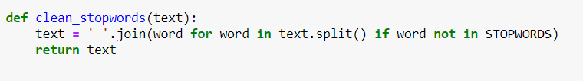
Data Preprocessing
Check for null values and remove
Convert into lowercase
Remove stop words
Notes:
talk about kaggle code

Slide 8
(5) Tokenizer
This class allows to vectorize a text corpus, by turning each text into either a sequence of words or tokens.A filter is applied to remove punctuations.
(6) Keras Pad Sequence
pad_sequences is used to ensure that all sequences in a list have the same length. By default this is done by padding 0 in the beginning of each sequence until each sequence has the same length as the longest sequence.

Slide 9
(7) GloVe Embedding(Global Vector for Word Representation)
GloVe aims to achieve two goals:
(1) Create word vectors that capture meaning in vector space
(2) Takes advantage of global count statistics instead of only local information
Unlike word2vec – which learns by streaming sentences – GloVe learns based on a co-occurrence matrix and trains word vectors so their differences predict co-occurrence ratios
GloVe weights the loss based on word frequency

Slide 10
LSTM (Long Short Term Memory)
Recurrent neural network that addresses machine learning’s inability to evaluate words based on meaning of previous words.
Capable of learning long-term dependencies.
Core structure relies on cell states. Information is regulated through gates.
Gates comprised of sigmoid and pointwise multiplication operation.
Sigmoid value (between 0-1) determines how much data can be added to cell state.

Slide 11
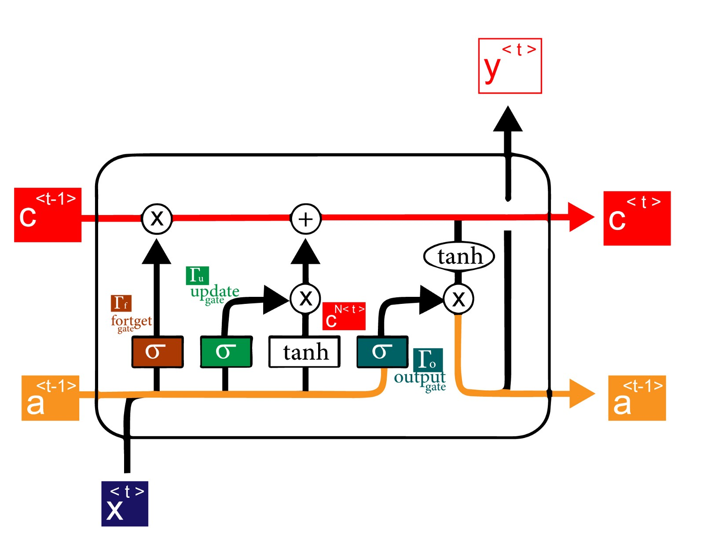
LSTM (Long Short Term Memory)
Sigmoid layer called the “input gate layer” decides which values will be updated.
tanh layer creates a vector of new candidate values, C~t, that could be added to the state.
Previous steps combined to create an update to the state.

Slide 12
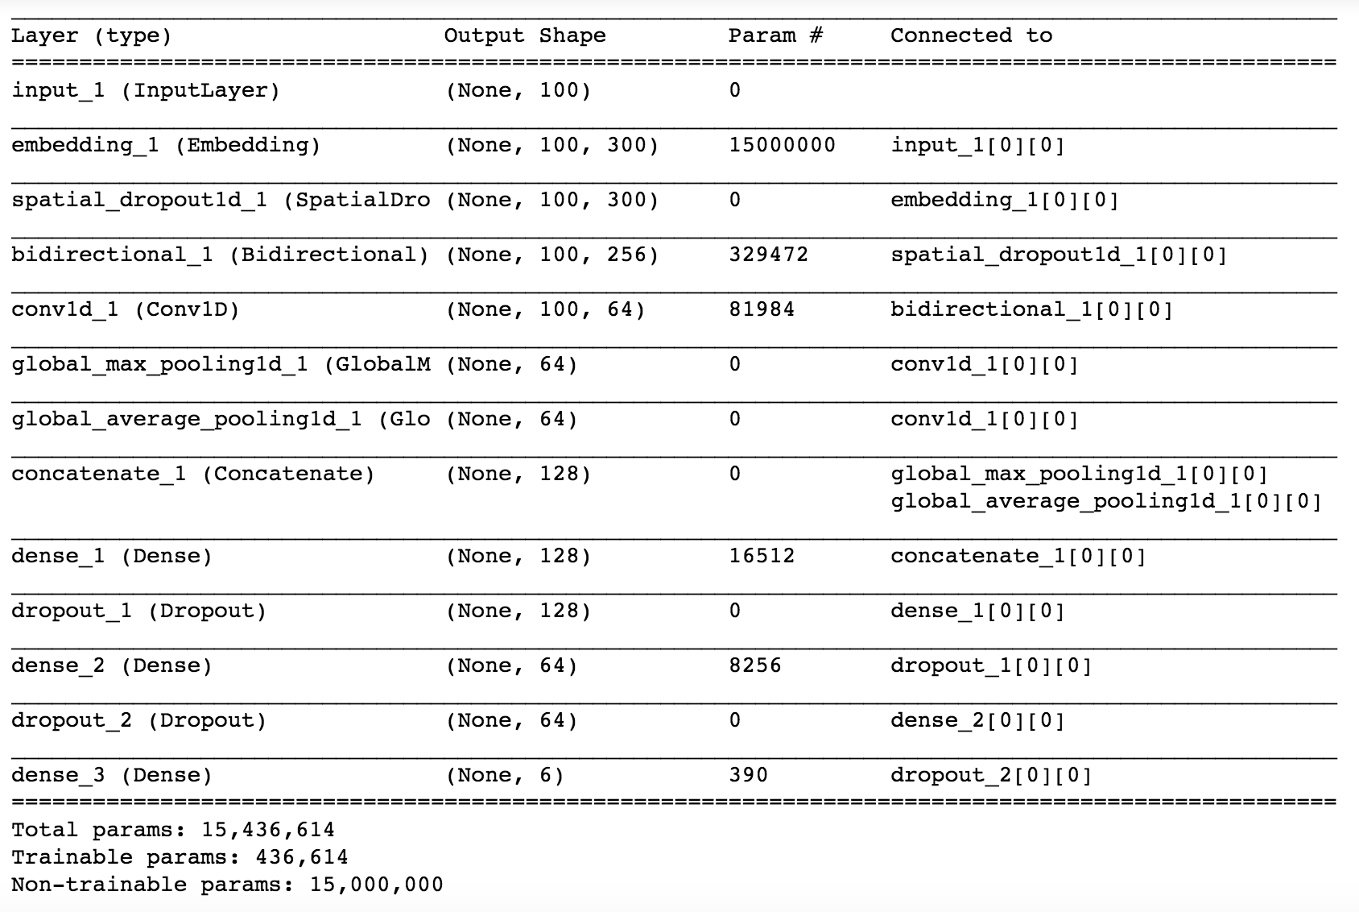
Model

Slide 13
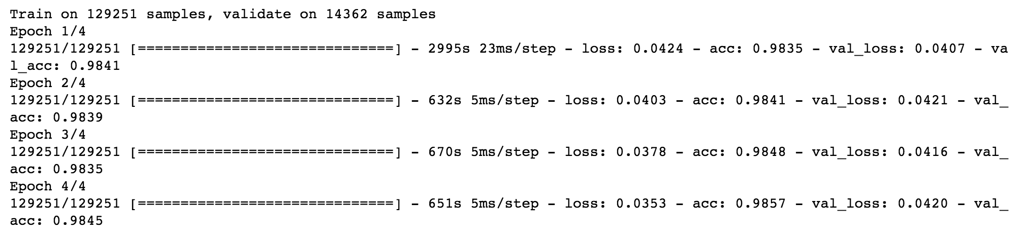
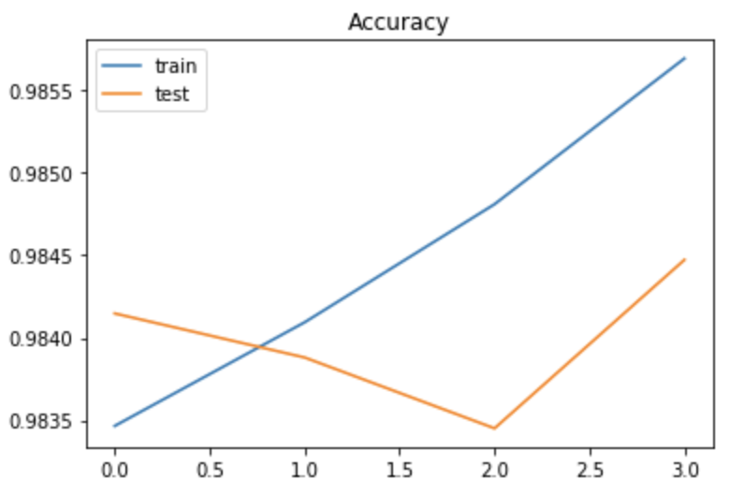

Results
Notes:
talk about kaggle code -- add results -- visualizations

Slide 14
Part 2:
Chrome Extension

Slide 15
Chrome Extension Basics
Languages: HTML, CSS, Javascript
HTML - Format of plugin
CSS - Styling
Javascript - used API key for http, calculation of toxic or harmless percentages

Slide 16
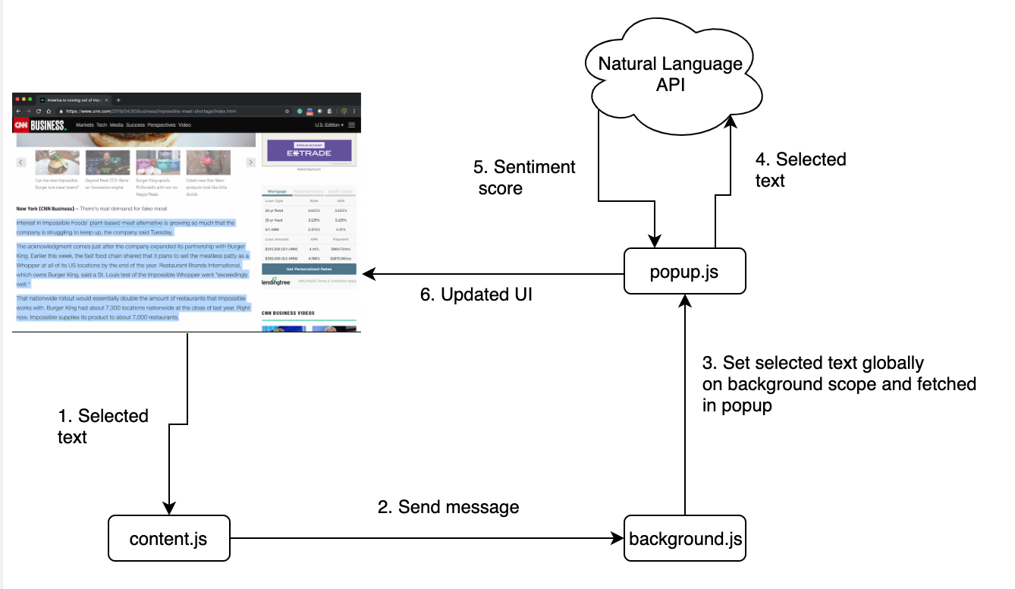
Chrome Extension Structure

Slide 17
Existing APIs
Google’s Cloud Natural Language API provides natural language understanding technologies to developers.
sentiment analysis
entity analysis
entity sentiment analysis
content classification
syntax analysis
Notes:
The Cloud Natural Language API provides natural language understanding technologies to developers, including sentiment analysis, entity analysis, entity sentiment analysis, content classification, and syntax analysis. This API is part of the larger Cloud Machine Learning API family.

Slide 18

Notes:
demo video

Slide 19
References
https://www.kaggle.com/c/jigsaw-toxic-comment-classification-challenge
https://thoughtbot.com/blog/how-to-make-a-chrome-extension
https://medium.com/@subodhgarg/how-to-build-chrome-extension-with-angularjs-googles-natural-language-api-370f9a4953e
https://cloud.google.com/docs/

Slide 20
Thank You!

